Slide 1

Analyzing Variables for Better Prediction
Andrea Carino
andrea.carino@ftwfoundation.org

Slide 2
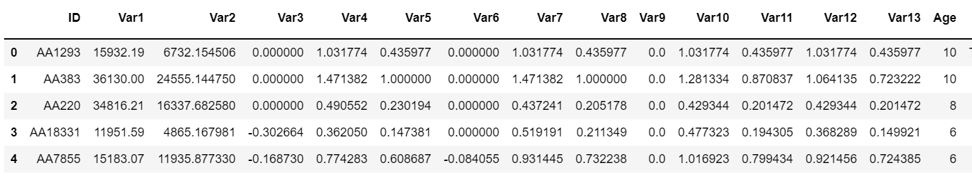
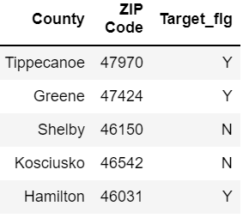
With the given dataset, our task is to determine which among the variables can better predict the target variable.
Target Variable
Predictive Variables
Note: Not all variables are appropriate to include in the analysis. Thus, we removed ID, County and ZIP Code from the data.

Slide 3
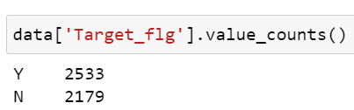
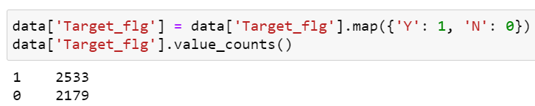
Looking into the target variable, it appears that the result is either classified as Y or N.
Since we need this for the analysis, we converted these into numbers wherein:
Y = 1
N = 0
Thus, we will use Logistic Regression to predict a classification. It is a simple algorithm that models a linear relationship between inputs and a categorical output.

Slide 4
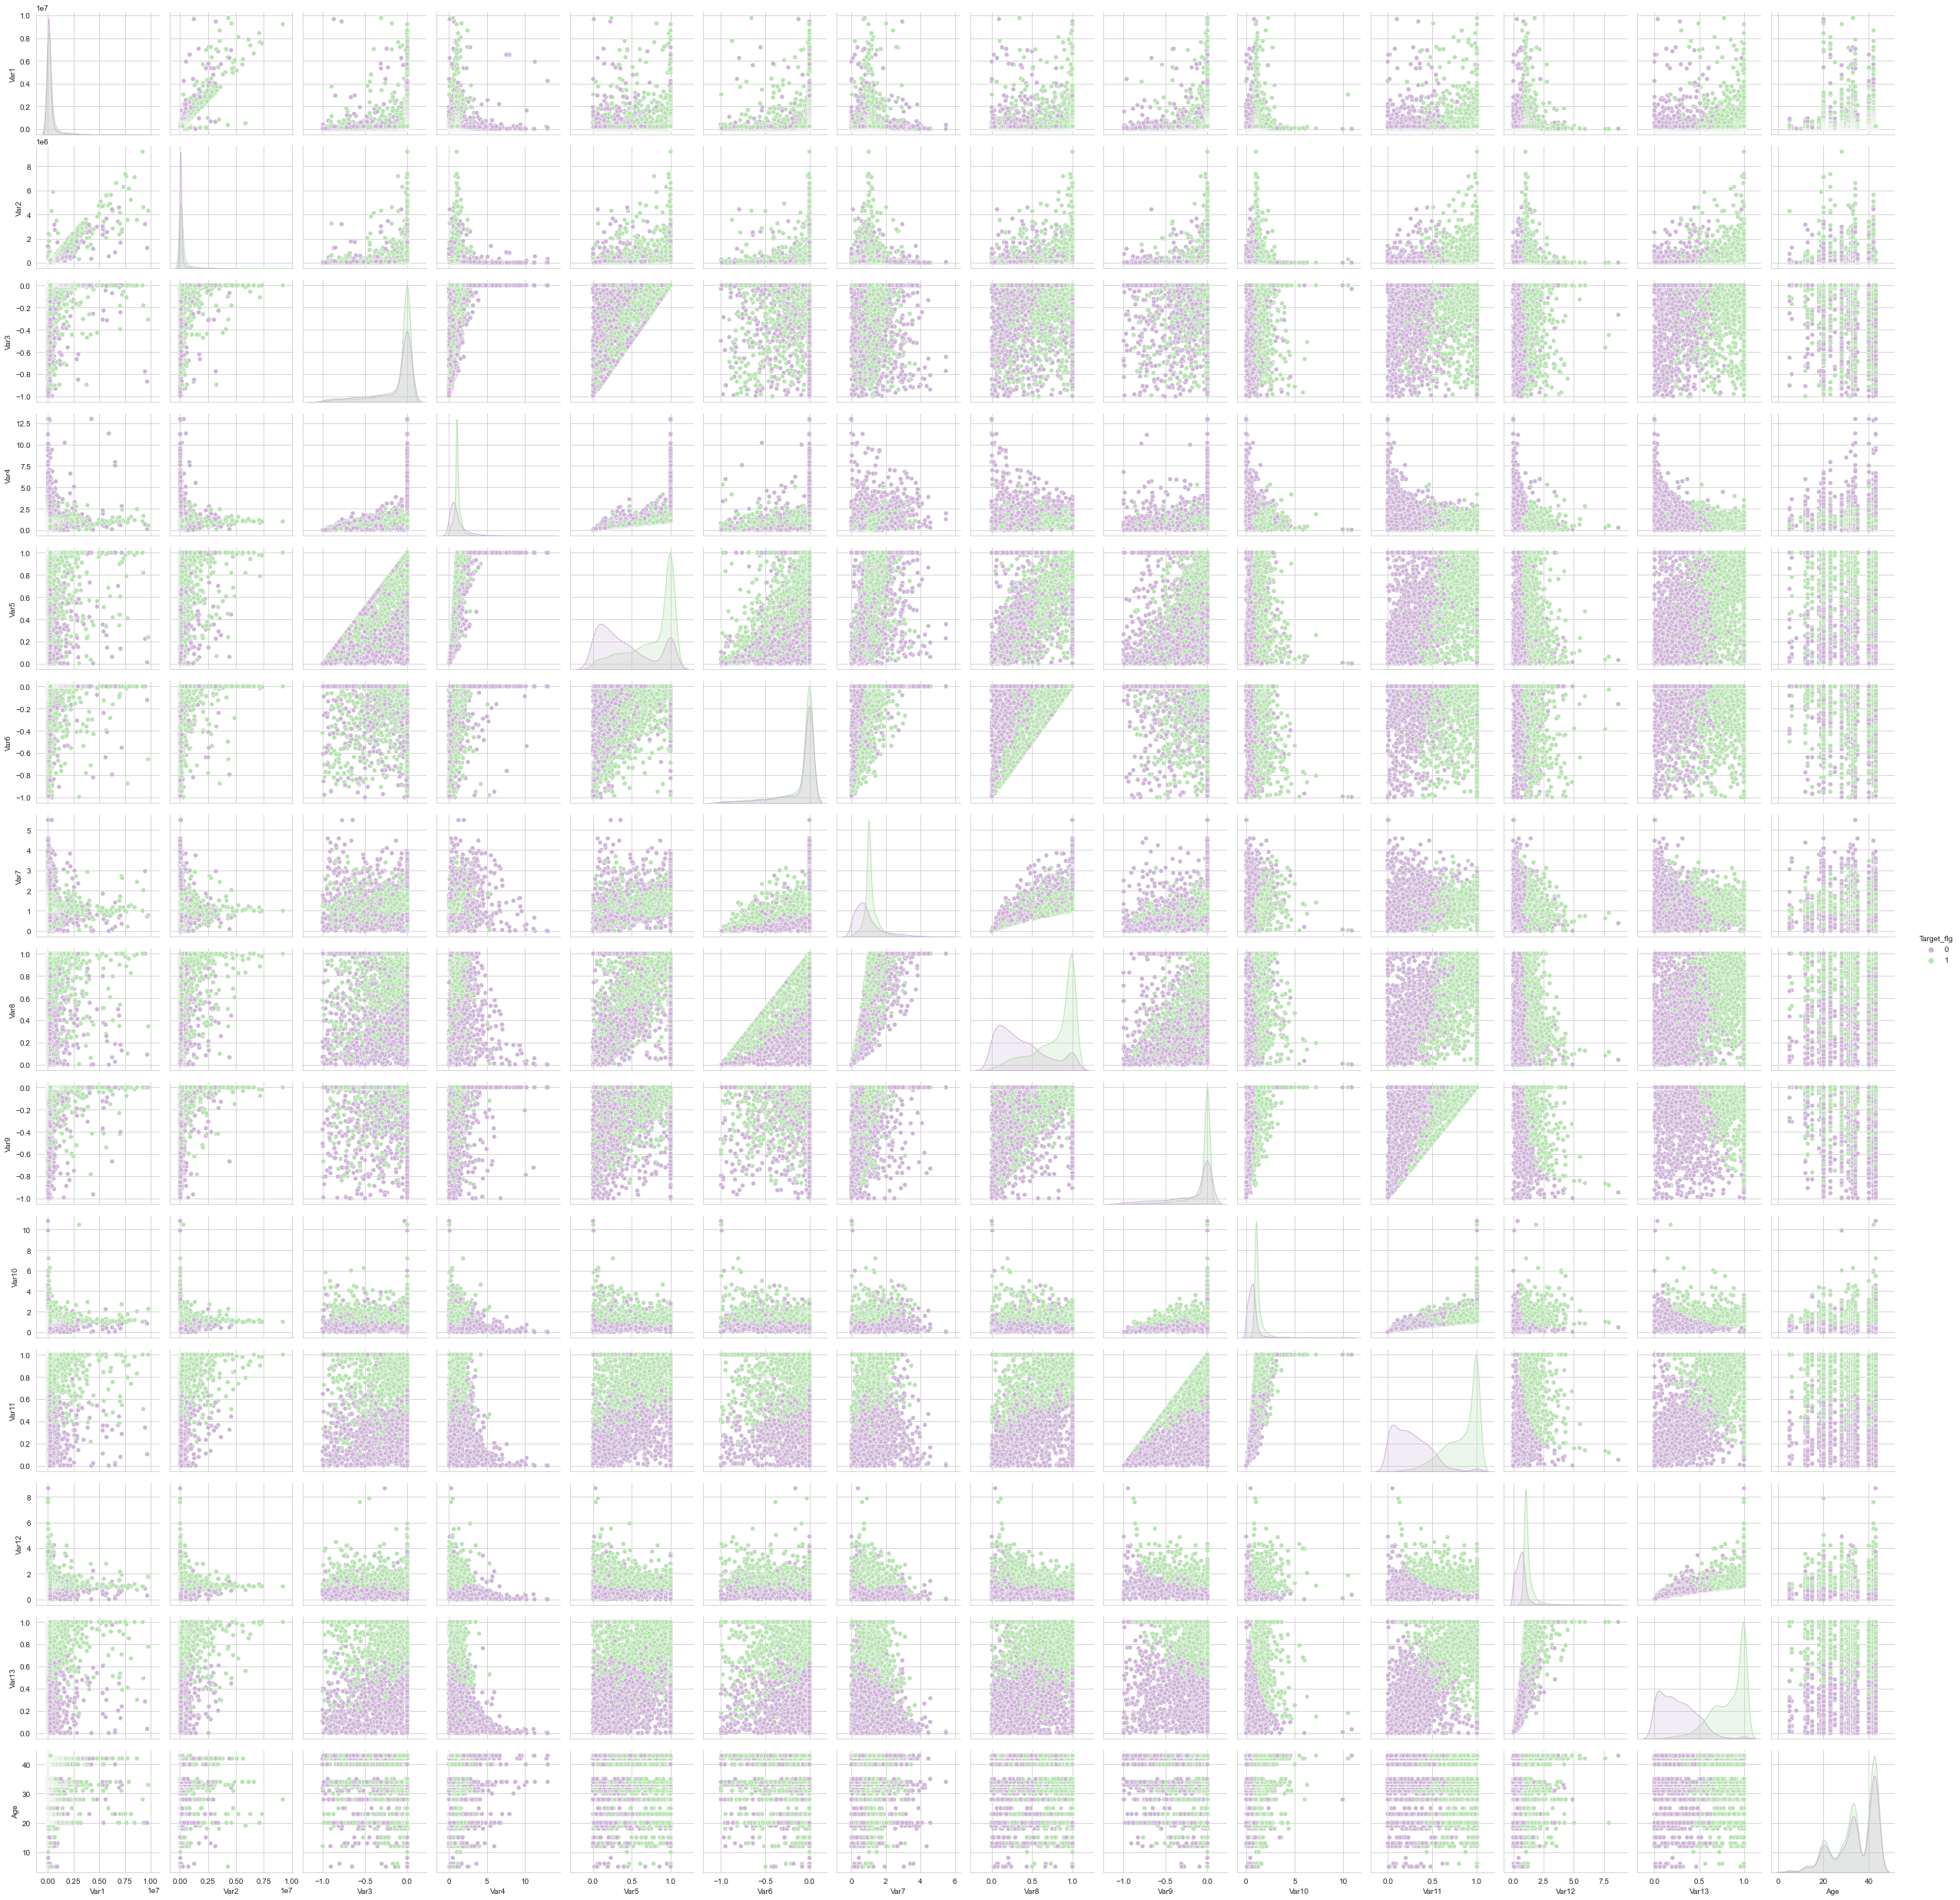
We used a pairplot to see the relationship between the variables.
Through this, we can determine the best variables to include in our analysis.
As shown by the plot, it appears that Age, Var3, Var5, Var6, Var8, Var9, Var11, and Var13 don’t have relationship with the other variables. Thus, we will not use these in the analysis.

Slide 5
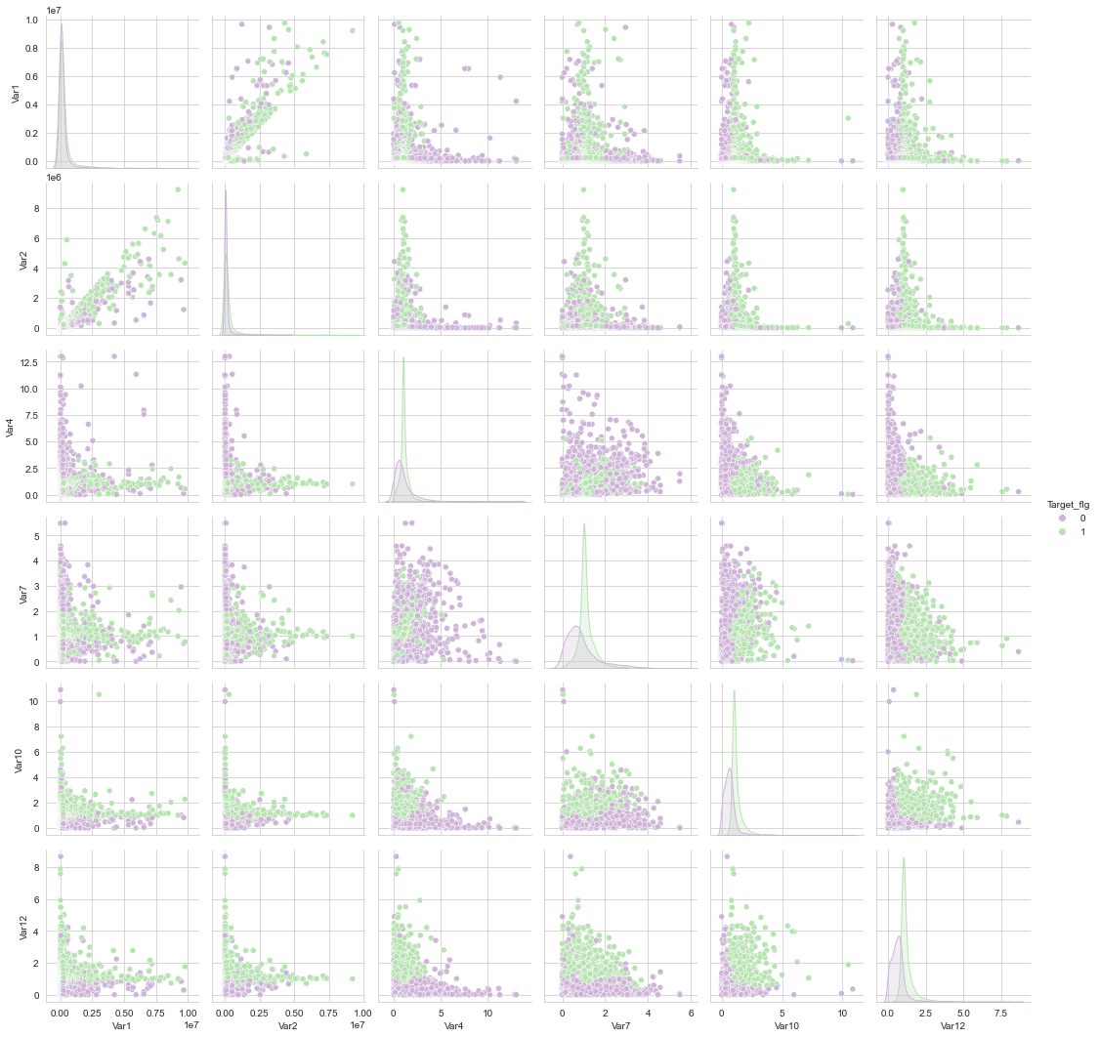
Now, we can clearly see the relationship of the remaining variables among each other.

Slide 6
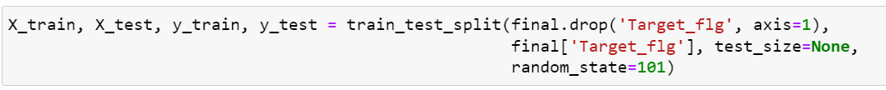
Using the data that we need, we will now build a logistic regression model.
Where:
X_train = All selected variables
Y_train = Target variable
test_size = proportion of dataset to include in the test split, we set it into None so it will automatically set into 0.25
random_state = controls the shuffling applied to the data before applying the split

Slide 7
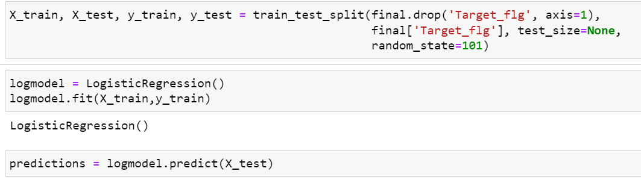
Using the data that we need, we will now build a logistic regression model.
Where:
X_train = All selected variables
Y_train = Target variable
test_size = proportion of dataset to include in the test split, we set it into None so it will automatically set into 0.25
random_state = controls the shuffling applied to the data before applying the split

Slide 8
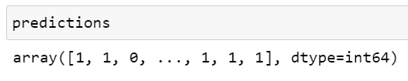
From the method applied, the predictions are as follows:
To check the capacity of the model to predict, we performed 2 metrics:
Classification Report
Confusion Matrix

Slide 9
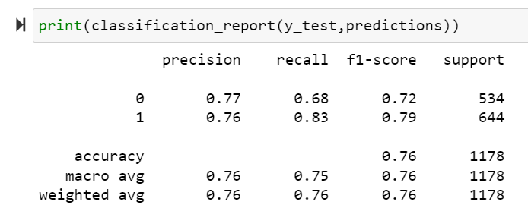
The Classification Report is used to check whether the predictions are either right or wrong.
Where:
Precision – percentage of correct predictions
Recall – positive cases captured by the model
F1 – percentage of correct positive cases
Support – number of actual occurrence

Slide 10
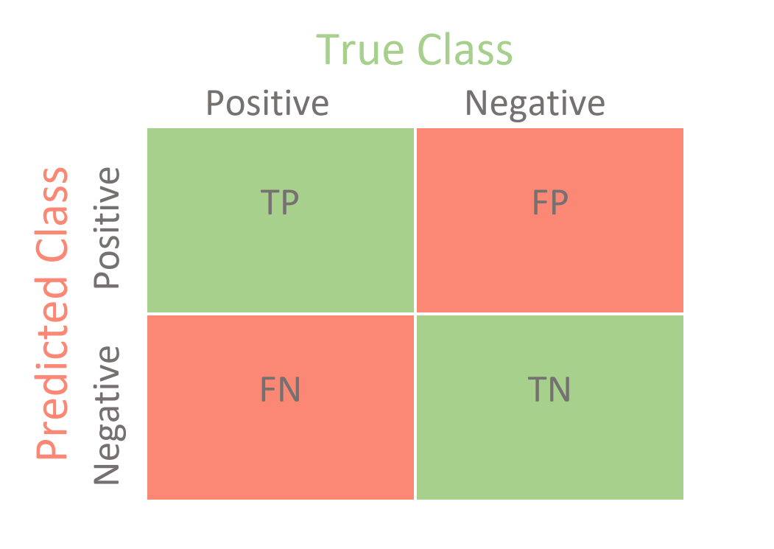
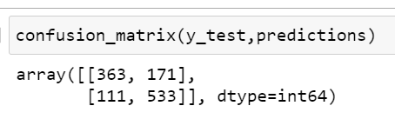
The Confusion Matrix is a table used to check the performance of the model.
As shown in the matrix, it appears that 896 cases were predicted by the model correctly which is 76% accurate.
Thus, the variables we used can be considered as predictors to effectively predict the target variable.
https://towardsdatascience.com/confusion-matrix-for-your-multi-class-machine-learning-model-ff9aa3bf7826
Where:
TP – True Positive
FP – False Positive
FN – False Negative
TN – True Negative

